Slide 1


Final IPR Meeting
Air Force ROTC Detachment 842
The University of Texas at San Antonio
C/Wargo
02 JAN 24

Slide 2


Overview
Volunteer List
Schedule
In-Processing Walkthrough Chart
Air Force ROTC Detachment 842 • We Build Exceptional Officers • The University of Texas at San Antonio

Slide 3
Emails to Recruits

Slide 4
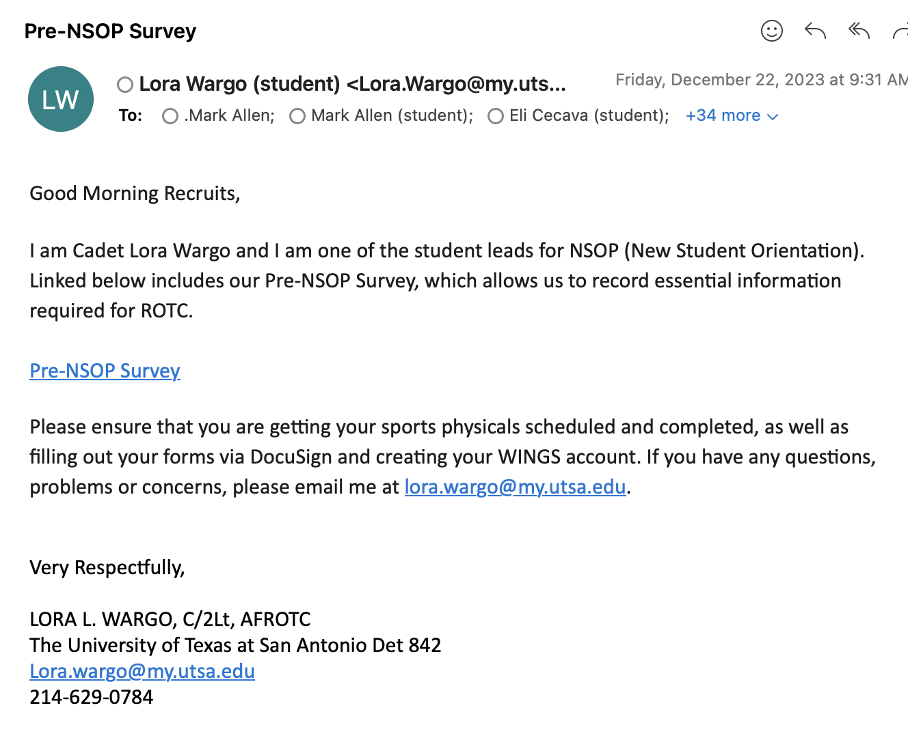
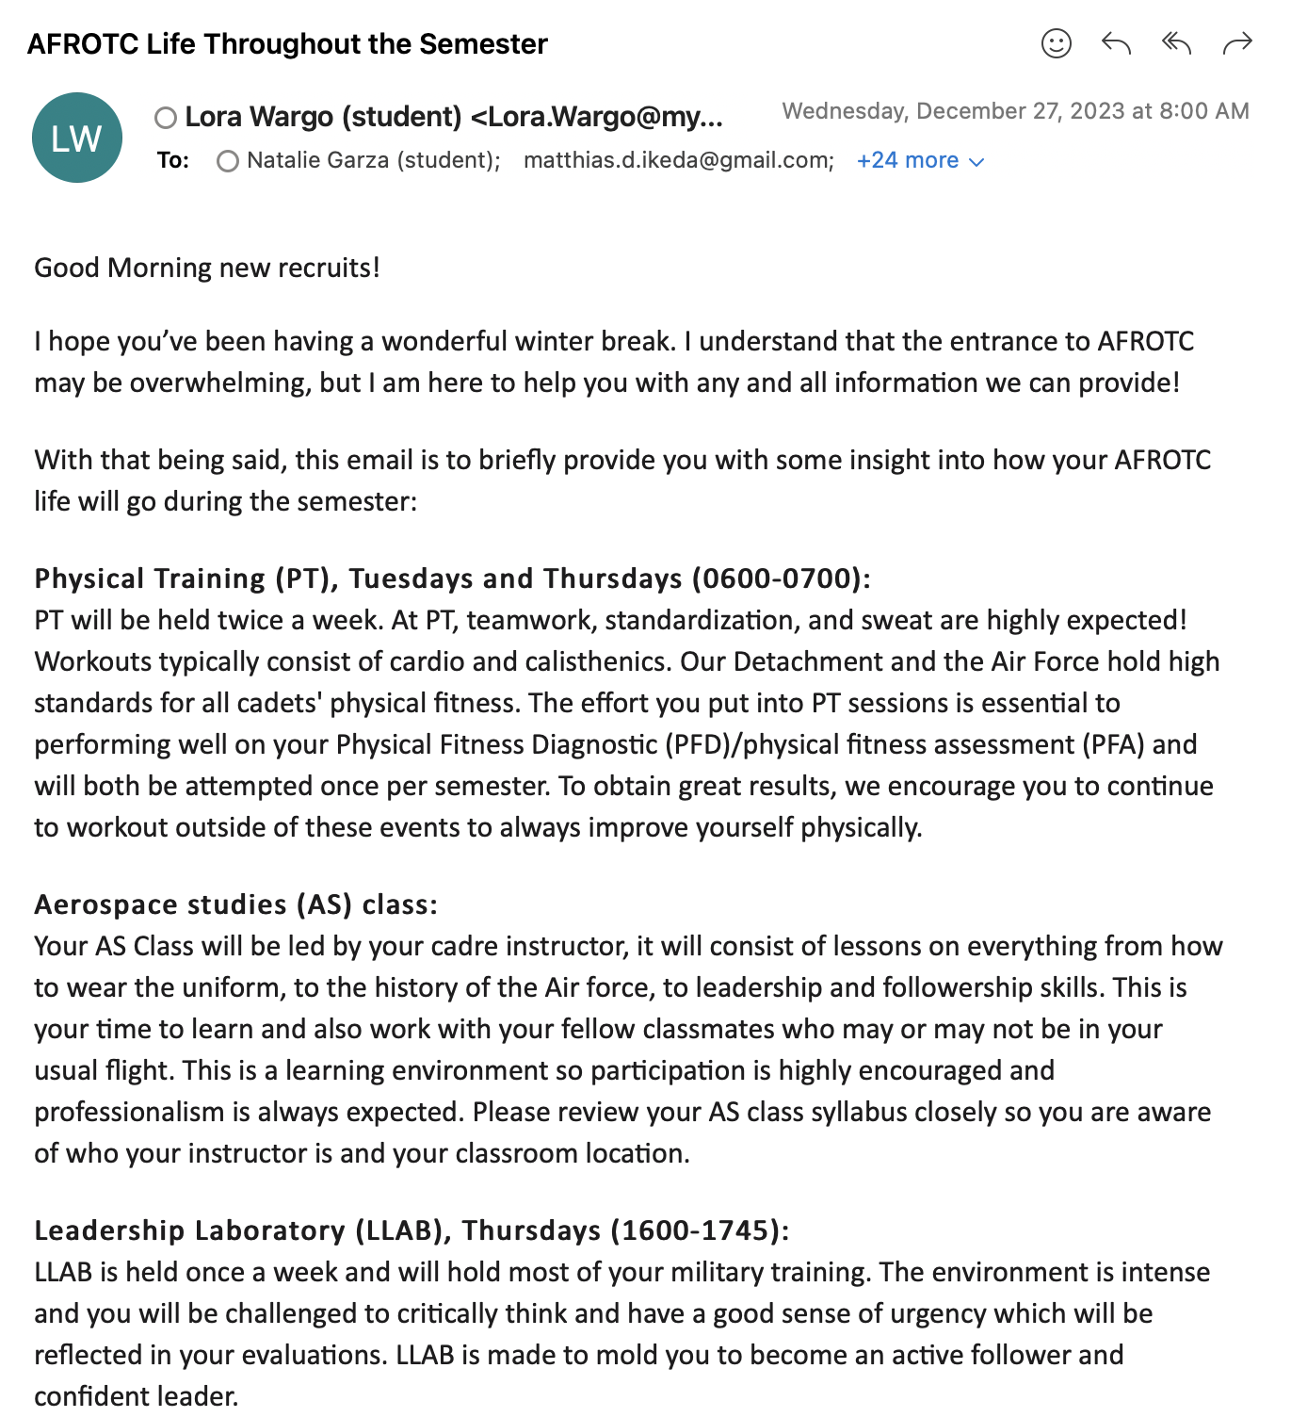
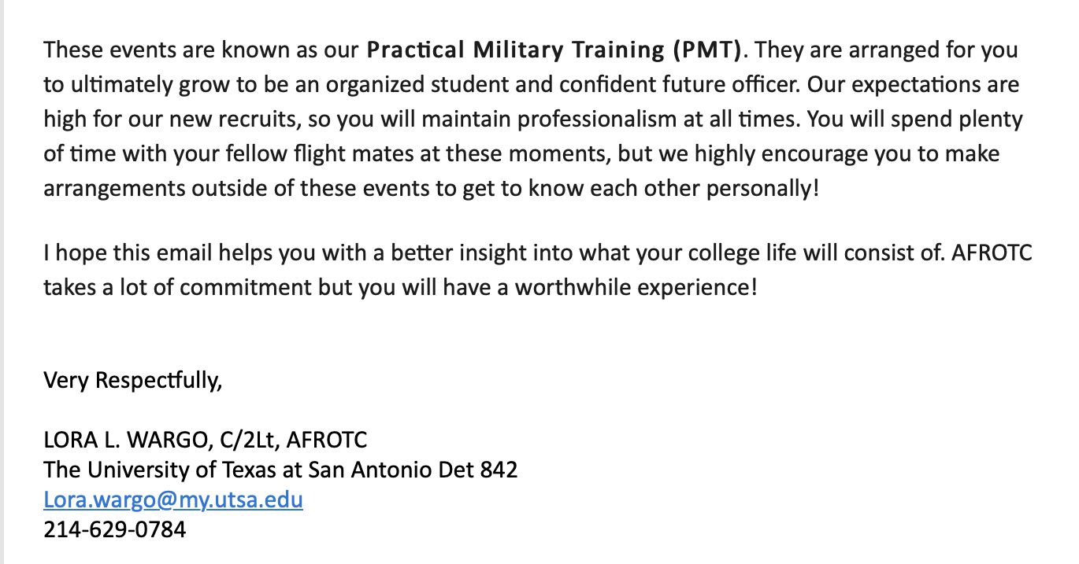
Past Emails to Recruits
Pre-NSOP Survey
AFROTC Life Throughout the Semester
Air Force ROTC Detachment 842 • We Build Exceptional Officers • The University of Texas at San Antonio

Slide 5
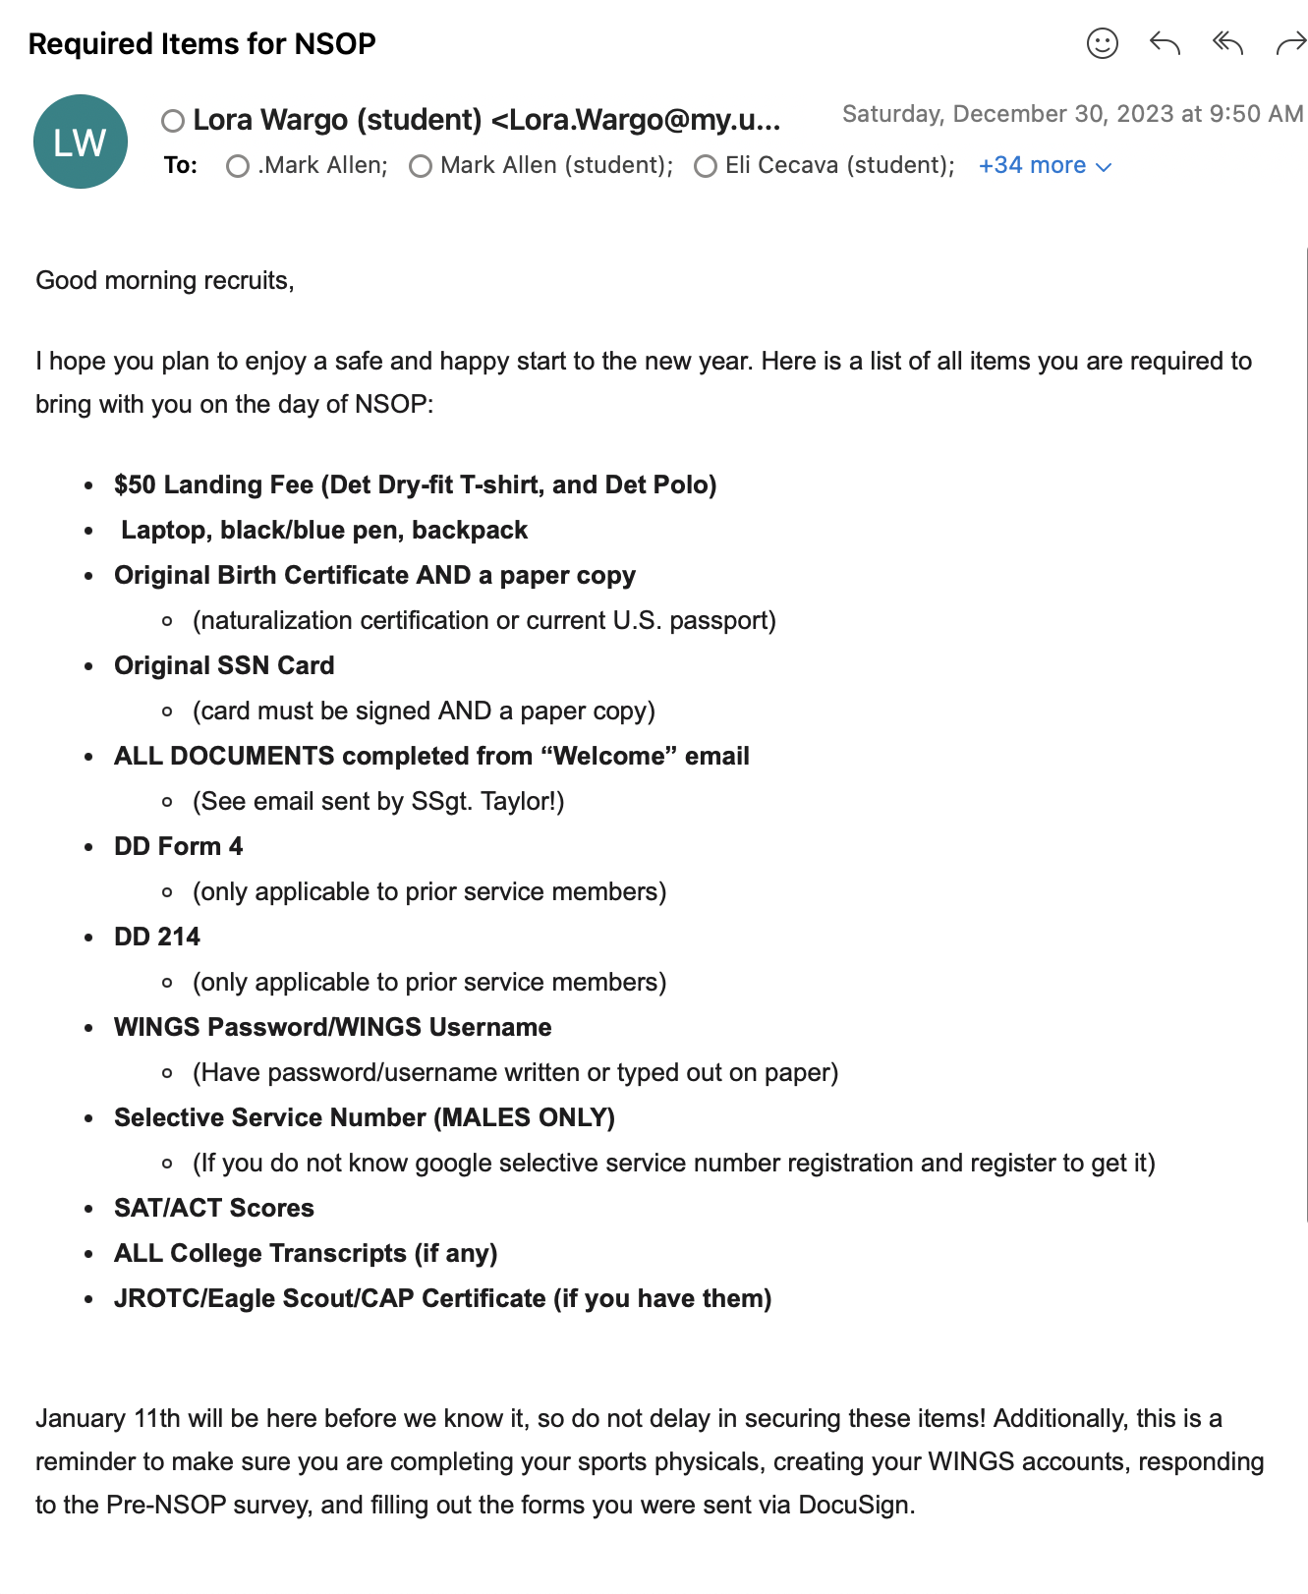
Past Emails to Recruits
Required Items for NSOP
Air Force ROTC Detachment 842 • We Build Exceptional Officers • The University of Texas at San Antonio

Slide 6
Pre-NSOP Responses
13 Responses Received (As of 1/3/2024 at 1047)
No Prior-Military
Air Force ROTC Detachment 842 • We Build Exceptional Officers • The University of Texas at San Antonio

Slide 7
Upcoming Emails to Recruits
NSOP UOD (01/03/2023)
Good (greeting) recruits,
You should already be aware, from an email sent out earlier by Staff Sergeant Taylor, that NSOP will be conducted on January 11th. NSOP is operated as a professional environment where you are expected to act and look your best. With that, the uniform of the day (UOD) will be Business casual (No Shorts or T-shirts, wear closed-toe shoes). Make sure you have all accommodations completed before this event.
When wearing our detachment polo (provided at NSOP), you will be required to wear khaki pants. If you do not own a pair, purchasing one sooner rather than later may be beneficial!
We are excited to meet every single one of you! If you have any questions, please email me. Thank you!
Week 1 Uniforms (01/04/2023)
Good (greeting) recruits,
In AFROTC, you are expected to wear a uniform specific to your class. This email contains the required uniform items which will vary depending on the environment (Physical Training, Aerospace Science Class, Leadership Laboratory).
Aerospace Science Class (AS Class) / Leadership Laboratory (LLAB)
Khaki pants (can be slacks or any pants material, preferably not skinny jeans)
Black backpack with minimal logos
Black watch
Black dress shoes
Det polo given @ NSOP
Physical Training (PT):
Light gray short sleeve T-shirt
Black shorts (can be any workout material, not tight/too short, think basketball shorts not running shorts)
Any color workout/running shoes
White socks
Same black watch
It is best to get these items ready before the semester starts!
Air Force ROTC Detachment 842 • We Build Exceptional Officers • The University of Texas at San Antonio

Slide 8
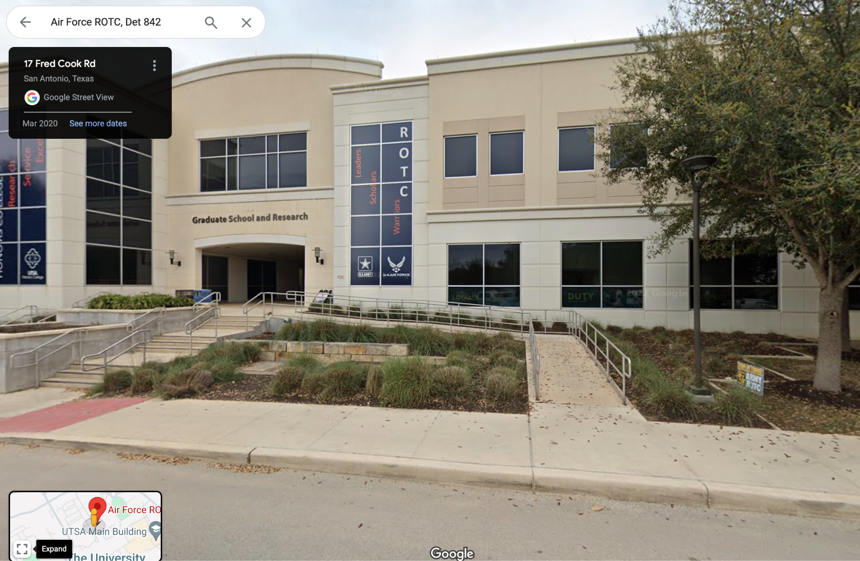
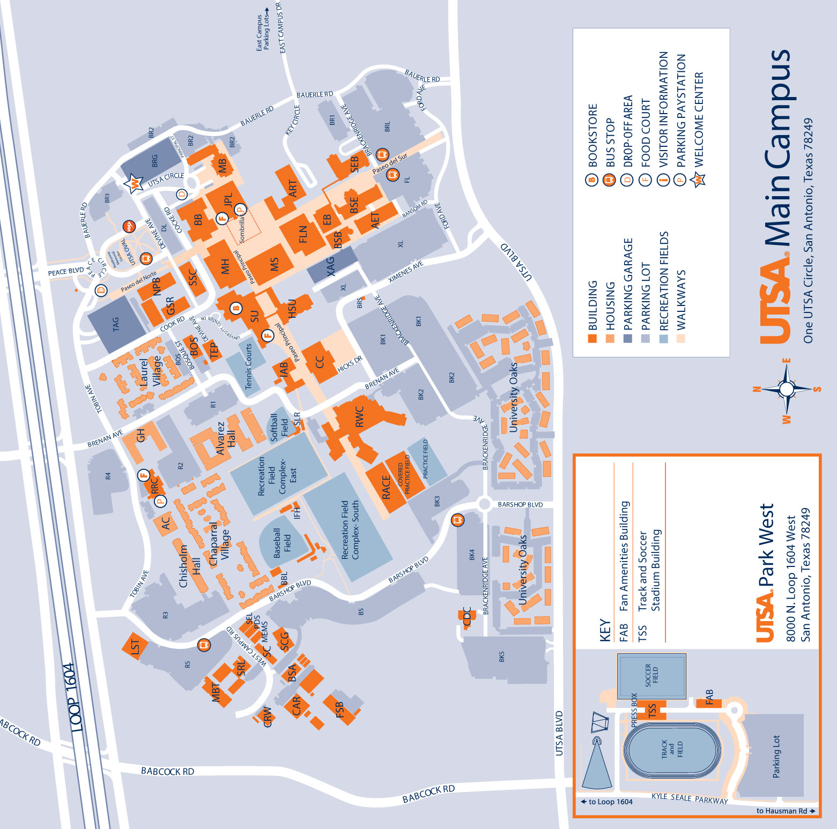
Upcoming Emails to Recruits
Official and Final NSOP Information (01/08/2023)
***Official NSOP Information***
Location of NSOP: Main UTSA Campus, Detachment 842
Graduate Studies and Research Building Room 1.220B
Address: 1 UTSA Circle, San Antonio, TX 78249
Air Force ROTC, Det 842
Arrival/End Time: 0900 - 1230; please maintain flexibility with the end time
Ensure you bring all required items mentioned in my earlier email. Please utilize the link below for reference.
Spring NSOP 2024 Required Items: CHECKLIST
Additional Items
Water, Snacks, Laptop Charger
Parking Location
It is important to familiarize yourself with the parking options on campus prior to NSOP. We highly recommend parking in the Tobin Parking Garage as it is closest to the detachment - a parking permit is not required but parking here does require you to pay a fee of $2.50/hr. Other locations will require you to have a parking permit, which can be purchased through the UTSA site.
The link below includes the address to the Tobin Parking Garage.
Address: Margaret Tobin Ave, San Antonio, TX 78249
UTSA Tobin Ave Garage
Attached below includes pictures for reference
Location of NSOP: Detachment 842
Map View → TAG == Tobin Parking Garage; GSR == Graduate Studies and Research Building
Air Force ROTC Detachment 842 • We Build Exceptional Officers • The University of Texas at San Antonio

Slide 9
Volunteer List

Slide 10
Volunteer List
1 | A-Staff | C/Irizarry
2 | A-Staff | C/Rosner
3 | A-Staff | C/Rodriguez, F.
4 |  | C/Anderson
5 |  | C/Eggers
6 |  | C/Arias
7 |  | C/Campbell
8 | LRS | C/Duquette
9 | LRS | C/Cavazos
10 | Booster Club | C/Schrecker
11 | Booster Club | C/Olivares
12 | Honor Guard | C/Fresquez
13 | i5 | C/Atkinson
14 |  | C/Vallor
15 |  | C/Scott
 | Back-Up 1 | C/Dzogbenuku
 | Back-Up 2 | C/Rodriguez, C.
 | Back-Up 3 | C/Burns
 | Back-Up 4 | C/Choi
Air Force ROTC Detachment 842 • We Build Exceptional Officers • The University of Texas at San Antonio

Slide 11
Volunteer List
Set-Up (0730-0830)
Role | Volunteer
Scales in Flight Sim Room & Flight Sim Room Looks Neat | C/Campbell
Scales in GMC Office & GMC Office Looks Neat | C/Rosner
Measurement Equipment: POC Office and Cadet Lounge | C/Duquette
Landing Fee Set-Up | C/Schrecker
Dry-fit and Polo Set-Up | C/Olivares
Dry-fit and Polo Set-Up | C/Schrecker
Table Set Up(Info and Physicals) | C/Cavazos
Table Set Up(NSO Table) | C/Atkinson
Table Set Up(Cap/JROTC and Prior Mil) | C/Vallor
Sign Placement | C/Rodriguez, F.
Sign Placement | C/Fresquez
Slides Set-Up | C/Scott
Photography | C/Eggers
Slack QR Code and Joint Classroom Looks Neat | C/Anderson
POC Office Looks Neat | C/Arias
Cadet Lounge Looks Neat | C/Duquette
In-Processing (0830-1000) |  | Briefings(1100-1200)
Role | Volunteer | Role | Volunteer
Female H/W: Flight Sim Room | C/Scott | Wing Queen Remarks | C/Irizarry
Male H/W: GMC Office | C/Fresquez | Uniform Wear(in Alternates) | C/Cavazos
Female Measurements: POC Office | C/Cavazos | Uniform Wear(in Alternates) | C/Duquette
Male Measurements: Cadet Lounge | C/Duquette | Silver Wings | C/Wargo
Landing Fee: Det Classroom | C/Schrecker | Honor Guard | C/Fresquez
Dry-Fits and Polos: Det Classroom | C/Olivares | i5 | C/Atkinson
Det Hallway Manager | C/Rodriguez, F. | Booster Club | C/Olivares
Joint Classroom Manager/Set-Up Slack | C/Anderson | Slide Manager | C/Scott
Breezeway Manager (Optional) | C/Rosner | Photography | C/Eggers
Confirm Info and Physicals Table: Joint Hallway | C/Arias
JROTC/CAP/Prior Mil Table: Joint Hallway | C/Vallor
NCO Runner 1 (also help during NCO Time) | C/Atkinson
NCO Runner 2 (also help during NCO Time) | C/Campbell
Photography | C/Eggers
Air Force ROTC Detachment 842 • We Build Exceptional Officers • The University of Texas at San Antonio

Slide 12
Schedule

Slide 13
Schedule
0730 Volunteer Arrival
0730-0830 Set-Up
0900 New Cadet Arrival
0900-1000: New Cadet In-Processing
Height Weight → Flight Sim Room and GM Office
Uniform Measurements → POC Office and Cadet Lounge
Landing Fee and Pickup Det Polo and Dry Fit → Det Classroom
Check Forms → Joint Classroom Foyer
Wait and Set-Up Slack → Joint Classroom
1000-1100: NCO Time → Joint Classroom
1100-1200: Briefings → Joint Classroom
Col Cyrus?
A-Staff Remarks
Uniform Wear
Honor Guard
Silver Wings
Booster Club
i5
Air Force ROTC Detachment 842 • We Build Exceptional Officers • The University of Texas at San Antonio

Slide 14
In-Processing Walkthrough Chart

Slide 15
In-Processing Walkthrough Chart
Arrive at Detachment
Wait in Holding Area;
Hallway outside Det;
C/Rodriguez, F.
Uniform Measurements
POC Office/Cadet Lounge
C/Cavazos and C/Duquette
If cadets pass
Height/Weight
Height/Weight
Flight SimRoom/GMC Office
C/Scott and C/Fresquez
If cadets fail Height/Weight
Exit Out Det Door and
Leave Towards Breezeway;
If directions needed,
then C/Rodriguez, F.
Transition to
Next Slide
Directions to Leave
in Breezeway;
C/ Rosner
Air Force ROTC Detachment 842 • We Build Exceptional Officers • The University of Texas at San Antonio

Slide 16
In-Processing Walkthrough Chart
Landing Fee ($50);
Det Classroom;
C/Schrecker
Pick-up DryFit and Polo;
Det Classroom;
C/Olivares
Exit Out Det Door and
Leave Towards Breezeway;
If directions needed,
then C/Rodriguez, F.
Directions to Joint Classroom
in Breezeway;
C/ Rosner
Confirm Info and Physicals
Joint Classroom Foyer;
C/Arias
NCO Table
Joint Classroom Foyer;
NCOs
Runners: C/Atkinson and C/Campbell
If CAP/JROTC/Prior Military
CAP/JROTC/Prior Military Table
Joint Classroom Foyer;
C/Vallor
else
Questions/Set-Up Slack/Holding Area
Joint Classroom;
C/Anderson
Air Force ROTC Detachment 842 • We Build Exceptional Officers • The University of Texas at San Antonio

Slide 17
Summary
Volunteer List
Schedule
In-Processing Walkthrough Chart
Air Force ROTC Detachment 842 • We Build Exceptional Officers • The University of Texas at San Antonio
Notes:
Should mirror the Overview

Slide 18
Questions?

Slide 19
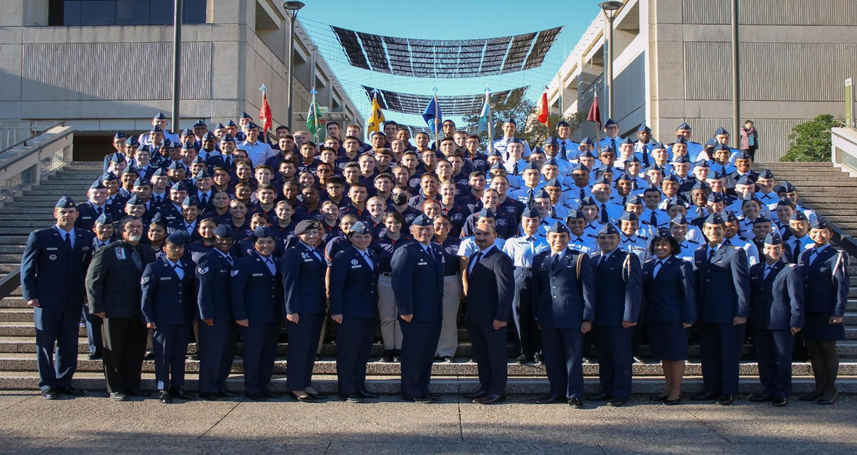
Air Force ROTC Detachment 842
The University of Texas at San Antonio
Det 842 – Best in Blue

